Slide 1





HEALRHCARE
PRESENTATION
ICU BED ASSIGNMENT OPTIMIZATION USING FUZZY LOGIC AND GENETIC ALGORITHM
PRESENTED BY- GOURAV RAVA, KESHAV, AYUSH BAHETI

Slide 2


PROBLEM STATMENT
Hospital Challenge:
150 patients in need of care
Only 40 ICU beds available
Select beds equipped with ventilators
Various specialties: Neurology, Cardiac, Respiratory, General
A balanced nurse workload is essential.
GOAL- Assign the best 40 patients to 40 ICU beds optimally

Slide 3


WHY OPTIMIZATION IS NEEDED?
Manual ICU triage is often slow and prone to errors.
Bed resources are limited.
Fair and medically sound prioritization is essential.
Balancing the workload among the team of four nurses is crucial.
Patients in critical need of ventilators must receive ventilated beds.

Slide 4




ICU BED ASSIGMENT
SYSTEM OVERVIEW
THIS PROJECT USES:
Fuzzy Logic → Calculates patient priority
Genetic Algorithm (GA)→ Selects best 40 patients & assigns beds
Multi-objective Optimization
Plots & CSV Outputs

Slide 5



Patient & BED Features
Borcelle
Medical
Each patient has:
Risk (1–10)
Age
Comorbidities (0–5 diseases)
Vitals severity (1–10)
Doctor recommendation (1–10)
Priority output (0–100)
Each ICU bed includes the following details:
Ventilator availability: Yes/No
Specialty type: Cardiac, Neuro, Respiratory, or General
Nurse group assignment: 1–4
Bed identification number: 1–40

Slide 6

Fuzzy Logic: Why?
Real-world medical decisions aren’t binary.
For instance:
A patient might be “50% elderly,”
“70% at critical risk,”
“30% with stable vitals.”
Fuzzy Logic effectively manages uncertainty and gradual severity.
Fuzzy Memberships
Examples:
Risk → Low, Medium, High, Critical
Age → Young, Middle, Elderly
Vitals → Stable, Moderate, Severe
Comorbidities → None, Few, Multiple
Uses Triangular Membership Function.

Slide 7




MEDICAL RULE OF FUZZY LOGIC
Laboratory
Rule Condition Score
1 Critical risk + Severe vitals 95
2 High risk + Severe vitals 85
3 Critical risk 80
4 Elderly + Multiple comorb. 75
5 Doctor rec > 7 70
6 Medium risk + Moderate vitals 50
7 Multiple comorbidities 60
8 Low risk + Stable vitals 30
Priority Example
Patient A:
Risk = 10, Vital = 9, Age = 78, Comorbidity = 3, Recovery = 8
Rules Triggered → 95, 80, 75
Priority = 83.33

Slide 8

GENETIC ALGORITHM
GA OVERVIEW
GA OBJECTIVE
GA STEPS
Population size: 100
Generations: 150
Mutation rate: 0.15
GA works like biological evolution:
Selection → best survive
Crossover → mix parents
Mutation → randomness
Repeat for 150 generations
Create random population
Compute fitness
Tournament selection
Order crossover
Mutation (swap patients)
Run 150 generations
Pick the best chromosome
GA optimizes:
Sum of patient priorities
Nurse workload balance
Ventilator matching
Specialty matching
Critical patients first
Best Fitness ExampleGeneration and Best scores 1: 3,500 ,30: 4,200, 60: 4,450, 90: 4,500 ,150: 4,533

Slide 9
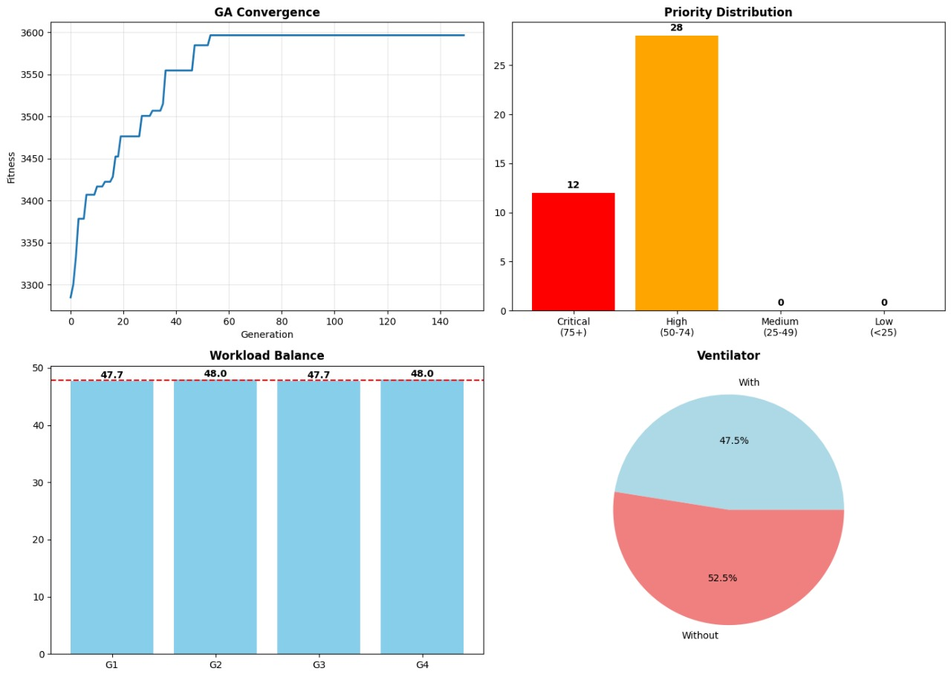

FINAL RESULTS
✔ 40 ICU beds assigned
✔ Critical patients prioritized
✔ Ventilators assigned correctly
✔ Nurse workload balanced
✔ Best Fitness = 4533
VISUAL OUTOUTS

Slide 10
CONCLUSION
Fuzzy Logic → Smart, human-like priority scoring
GA → Finds optimal assignment in huge search space
Balanced, fair, medically-sound ICU allocation
Works even with 150 patients + 40 beds
GOOGLE COLLAB Link-https://colab.research.google.com/drive/1C89KtxPB_wuMYcPEbJ7pnZz-iKFtr9UF?usp=sharing

Slide 11

Thank
You.
ANY QUESTIONS?

